Slide 1


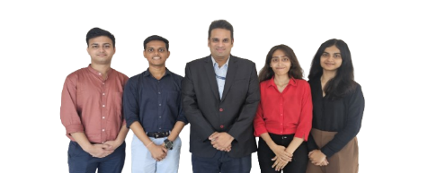
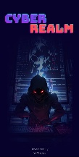
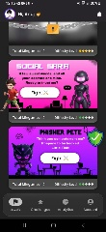
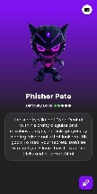
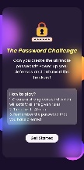
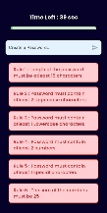
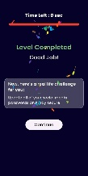
Department : Computer Engineering
Project Title : CyberRealm: A Gamified Cybersecurity Education Platform for Teenagers
Domain (Area of Project) : Cybersecurity, E-Learning
Name of Project Guide : Dr. Amit Nerurkar (amit.nerurkar@vit.edu.in)
Name of Students : Sakshi Savardekar (sakshi.savardekar@vit.edu.in)
Anuj Ramane (anuj.ramane@vit.edu.in)
Ayush Danao (ayush.danao@vit.edu.in)
Sharyu Sonavane (sharyu.sonavane@vit.edu.in)
Brief idea of Project : “CyberRealm” is a gamified mobile application designed to revolutionize cybersecurity education for teenagers. Unlike existing costly, non-gamified websites that aren’t beginner-friendly and lack mobile support, CyberRealm offers a dynamic, accessible solution. Key features include Story Mode with narrative-based cyber battles, Live Challenges with multiplayer mini-games and leaderboards, Learning Analytics for personalized progress tracking, Cryptic for hands-on cipher simulations, and AI-Generated Challenges that adapt to each user’s skill level. The app makes learning cybersecurity fun, engaging, and effective.
Screenshots of the Project / Photos of Working Model (Min.3):
Applications :
  Integration in schools, diploma, and undergraduate curriculums to make cybersecurity education interactive.
  Can be used for corporate upskilling
  Self-paced learning for teens and young adults.
Awards/Participation if Any for TPP / Competitions / Paper Publication / Any Other Pls. Specify: --
  Winners of Tantravihar-2024 for our module “Cryptic - Cipher Simulator” in Innovation Track.
  Participation in Tantravihar-2025
  Reached finals of Zonal Round in Avishkar 2025 competition.

